Slide 1

Purple colour theme to match the colour of the movie bowling club colours
Text information (Introduction)

Slide 2
Image of character – name and real name with link to profile on the IMBD movie site.

Slide 3
Collection of movie images

Slide 4
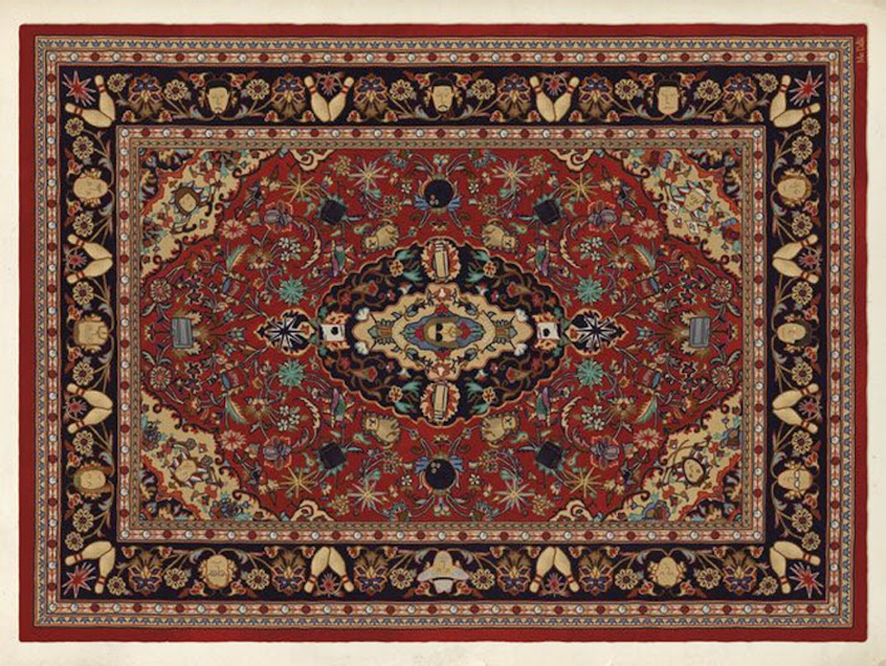
Movie trailer
Background image of ‘The Dudes’ carpet

